Slide 1
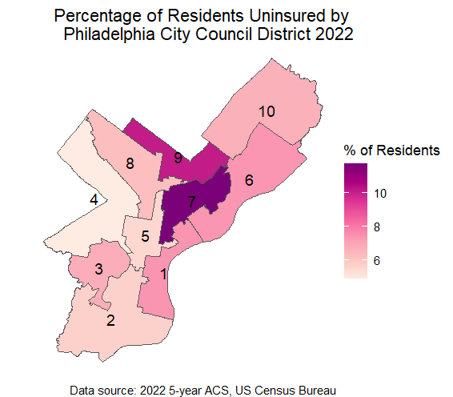
Health Insurance

Slide 2
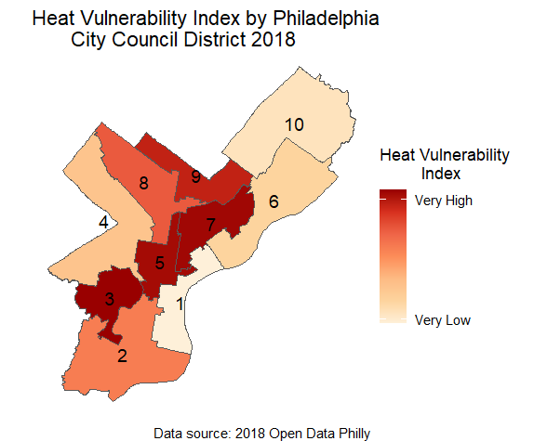
Heat Vulnerability Index

Slide 3
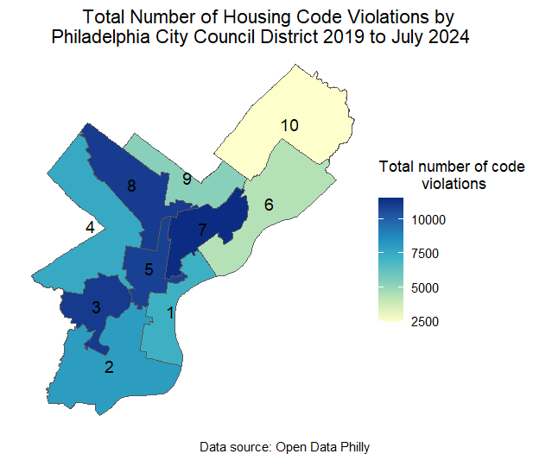
Housing Code Violations

Slide 4
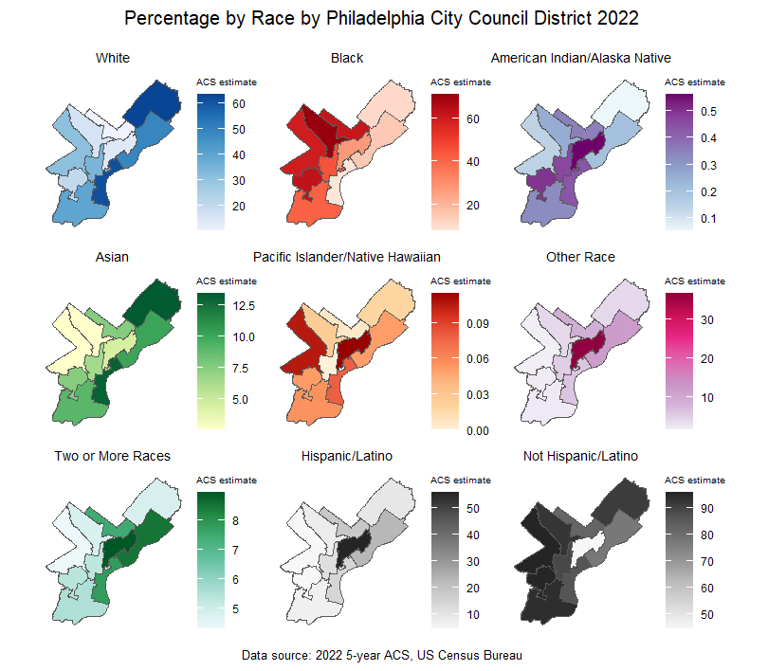
Race

Slide 5
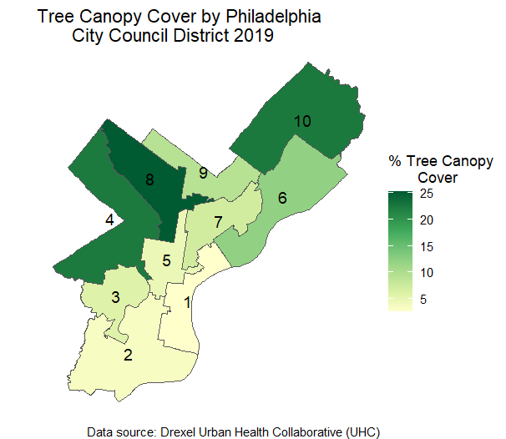
Tree Canopy Cover

Slide 6
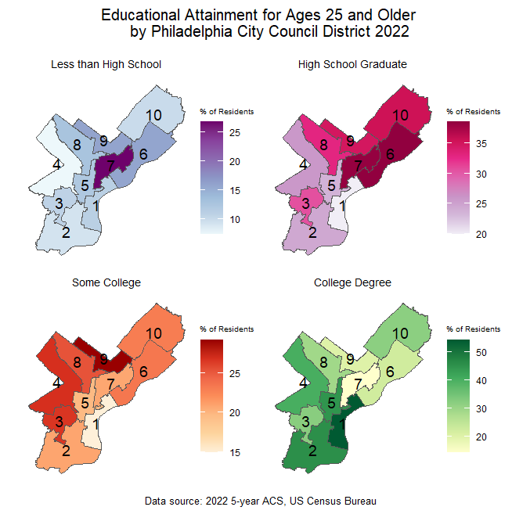
Educational Attainment

Slide 7
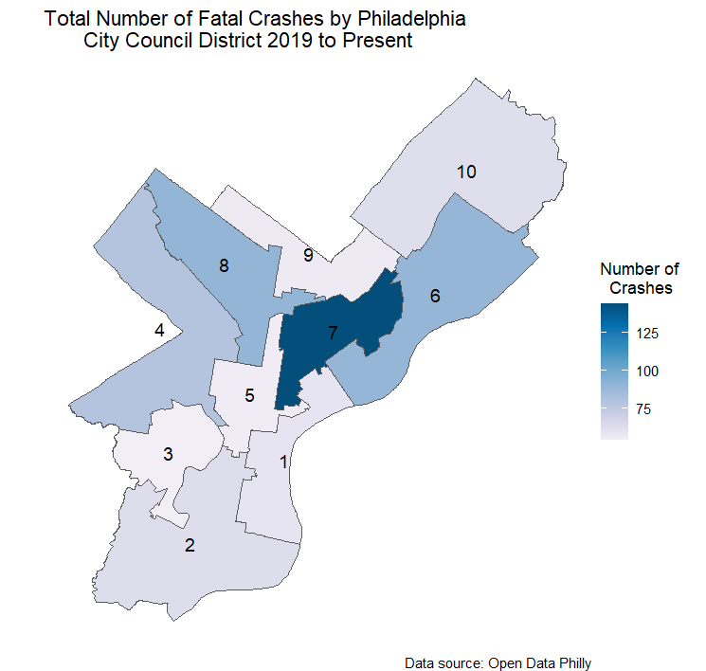
Fatal Crashes

Slide 8
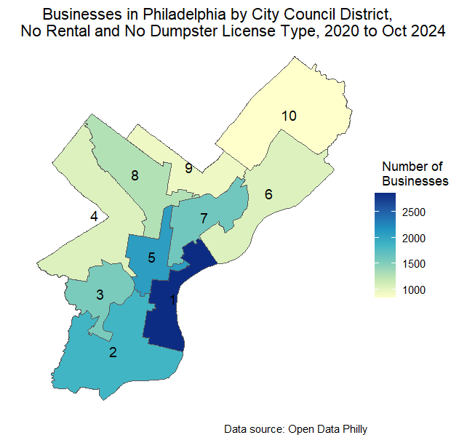
Active Business Licenses (NO RENTAL SHOWN)

Slide 9
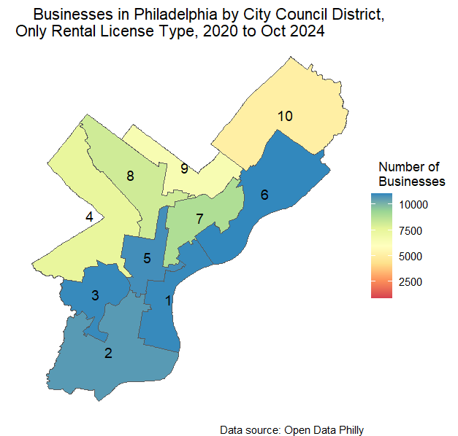
Active Business Licenses (Only RENTAL SHOWN)

Slide 10
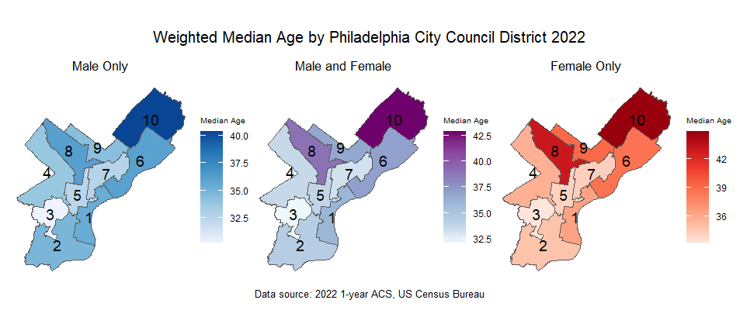
Median Age

Slide 11
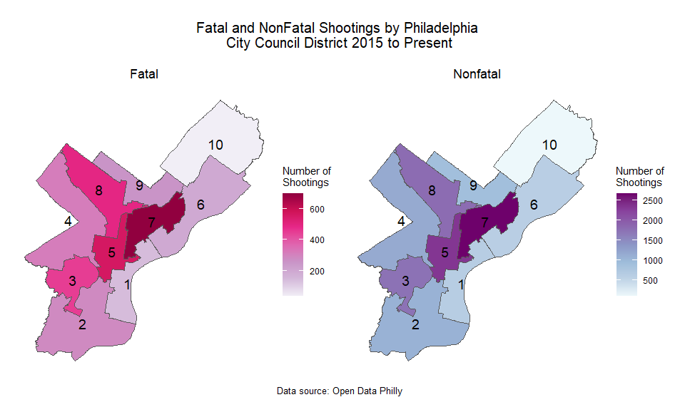
Fatal and Nonfatal Shootings

Slide 12
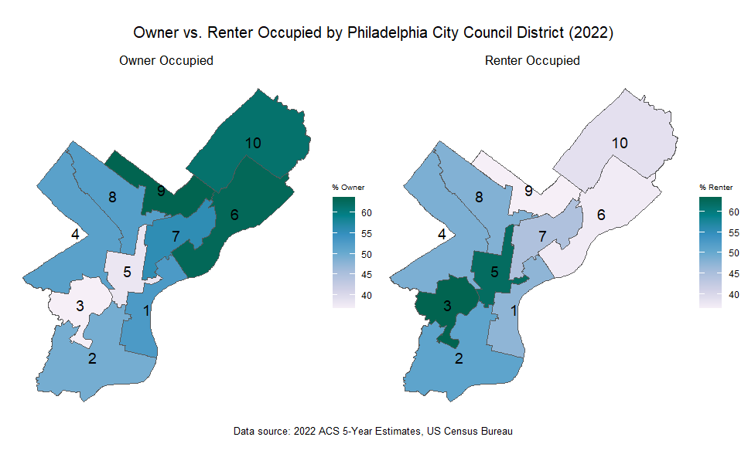
Owner vs. Renter

Slide 13
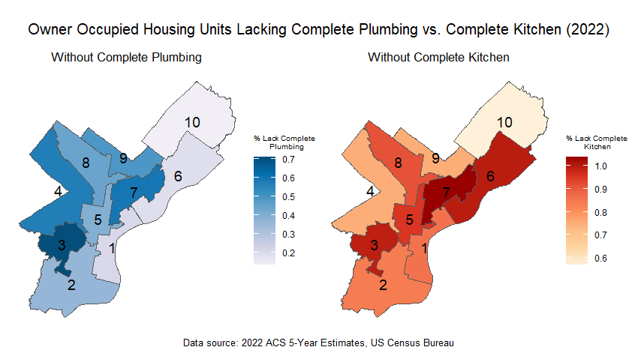
Without Complete Kitchen/Plumbing

